Slide 1
Hackathon’25 : Solve Rubik’s Cube

Slide 2
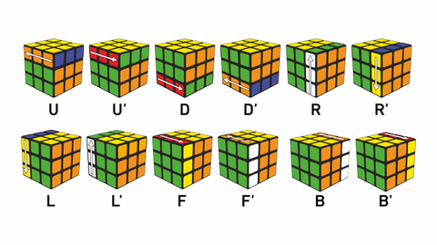
Solve Rubik’s Cube
Overview
Participants are challenged to design and implement an algorithm that can solve a standard 3x3 Rubik’s Cube from any scrambled state. The solution must mimic the real-world logic of solving a cube through a sequence of valid moves.
What We’re Looking For : 🔍
Problem-Solving Approach
How do you break down the problem?
How do you model the cube’s state and transitions?
Use of Data Structures
How do you represent the cube internally (e.g., arrays, trees, graphs)?
Use of efficient structures to track states and operations.
State Prediction Logic
Ability to track and predict cube state after each move.
Design of a move engine to simulate rotations and track permutations.
Algorithm Efficiency
How fast can your solution reach the solved state?
Complexity (time and space) of your algorithm.
Bonus Evaluation Areas
Creativity in solution design.
Visual simulation or cube UI (optional but Wow factor).
Scalability for different cube sizes (2x2, 4x4, etc.) : Optional
Deliverables:
Working algorithm (code)
Brief walkthrough/presentation of your approach
Output example(s) from your solver
It’s Not Just a Puzzle - It’s a Test of Mind, Math, and Moves!

Slide 3
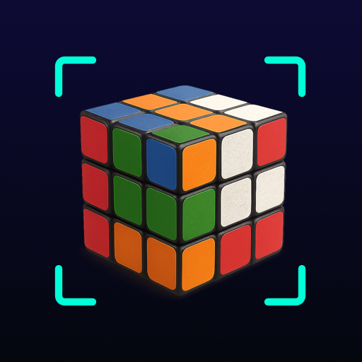
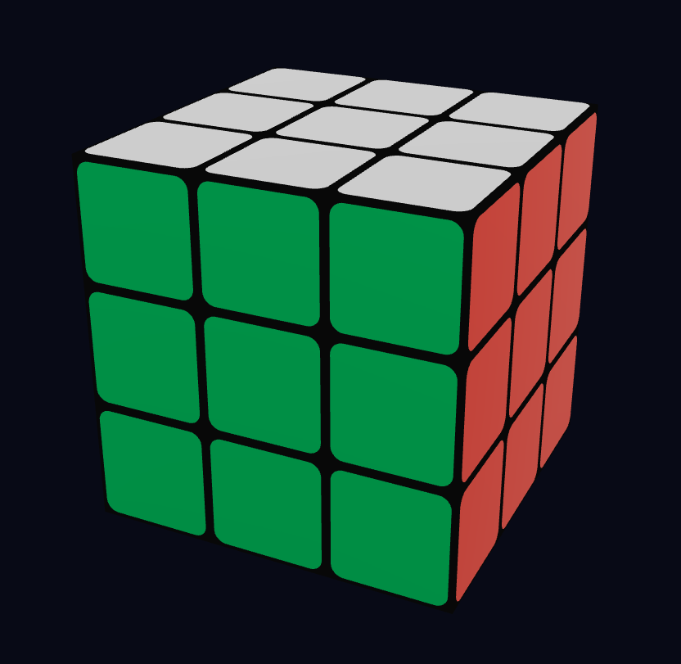

Title : Vision-Based Rubik’s Cube Solver Solving the cube using a webcam and 3D intelligence
"Scan. Solve. Simulate."
"A good solution doesn’t just solve the cube – it helps others understand the logic behind it."

Slide 4
Problem Statement:
Solving a 3x3 Rubik’s Cube requires understanding the cube's configuration and applying a sequence of valid moves.
Manually solving it is complex for beginners and time-consuming even for experts.
Objective:
Design and implement an algorithm that mimics human solving logic by scanning a real cube using a camera and solving it digitally.
"A good solution doesn’t just solve the cube – it helps others understand the logic behind it."

Slide 5
Problem solving approach :
1. How do you break down the problem?
Module 1: User Input & State Acquisition (The "Eyes")
Problem: How can a user input a scrambled cube's state easily and accurately?
Solution: Pivoted away from a tedious manual input method to an innovative camera-based scanning interface. This eliminates user error and provides an intuitive "point-and-shoot" experience. This module's sole job is to see the cube and capture its colors.
Module 2: Computer Vision & State Translation (The "Brainstem")
Problem: How do we convert the raw camera image into a format a computer can understand?
Solution: We developed a lightweight computer vision engine in JavaScript. It samples pixels from the video feed, intelligently matches them to the closest known cube colors, and translates the six scanned faces into a single, standardized 54-character "state string."
Module 3: The Solving Engine (The "Grandmaster")
Problem: How do we find the most efficient solution from any given state?
Solution: We made a strategic decision to integrate a proven, world-class solving library, Cube.js. This guarantees a highly optimal and correct solution every time, allowing us to focus on building the innovative interface around it.
Module 4: Visualization & User Feedback (The "Show")
Problem: How do we present the solution back to the user in a clear and engaging way?
Solution: We used Three.js to render a polished 3D model of the cube. The solution provided by the solver is then animated step-by-step, providing a satisfying visual payoff that confirms the solution's validity.

Slide 6
2. How do you model the cube's state and transitions?
State Modeling: We represent the cube's state using the most efficient and standard format available: a 54-character string. Each character in the string corresponds to a single sticker on the cube, using letters like 'U' for the Up-face color (White), 'F' for the Front-face color (Blue), etc. This model is compact, easy to manage, and is the required input for the high-performance solving library.
Transition Modeling: We have a clear separation of concerns for transitions:
Logical Transitions: The "move engine" that tracks permutations is handled entirely by the Cube.js library. It contains a perfect mathematical model of how a move like 'R' or "U'" permutes the 54-sticker state string.
Visual Transitions: Our custom code is responsible for the visual transition engine. The performMoveAnimation function takes a move name (e.g., 'F2') and translates it into a physical rotation of the correct cubies in the 3D scene, ensuring the visual model always matches the logical solution.
=
"A good solution doesn’t just solve the cube – it helps others understand the logic behind it."

Slide 7
Use of Data Structures
1. How do you represent the cube internally?
We use three primary data structures, each chosen for its specific purpose:
Object (for Scanned Data): During the scanning phase, the state is stored in a JavaScript Object: {'U': ['U','R','B',...], 'L': [...]}. This provides a readable, key-value structure that is perfect for progressively building the cube state face by face.
String (for Solving): Once scanning is complete, the Object is flattened into the 54-character String. This is the primary logical representation used for the solving algorithm.
Array (for the Solution): The solver's output string is immediately parsed into an Array of moves (e.g., ['R2', 'U'', 'F']). This is the ideal structure for iterating through the solution one move at a time during the animation phase.
2. Use of efficient structures to track states and operations.
Efficiency was a key consideration. The String representation is highly efficient for the solver, as it's a primitive data type that is easy to hash, copy, and compare. The final solution is stored in an Array, which provides O(1) access to the next move in the sequence, making our animation loop extremely fast and simple. We avoided complex data structures where they weren't necessary, opting for the most direct and performant tool for each job.
"A good solution doesn’t just solve the cube – it helps others understand the logic behind it."

Slide 8
State Prediction Logic
1. Ability to track and predict cube state after each move.
The architecture strategically delegates this responsibility. The Cube.js solver handles all logical state tracking. Its internal engine can perfectly predict the resulting state string after any sequence of moves. Our application code does not need to replicate this complex logic; instead, it trusts the solver to provide a correct, end-to-end sequence of moves.
2. Design of a move engine to simulate rotations and track permutations.
As mentioned, we have two engines:
Permutation Engine: We integrated the robust and flawless permutation engine within Cube.js. This was a conscious design choice to ensure 100% accuracy and reliability.
Rotation (Animation) Engine: Our custom-designed engine is the performMoveAnimation function. It takes a move command, identifies the correct Three.js objects based on their 3D position, groups them into a temporary pivot object, and uses the TWEEN.js library to execute a smooth, visually appealing rotation.
"A good solution doesn’t just solve the cube – it helps others understand the logic behind it."

Slide 9
Algorithm Efficiency
1. How fast can your solution reach the solved state?
Our application is exceptionally fast in two different ways:
Computational Speed: The solver finds a solution in milliseconds. Cube.js uses pre-calculated data tables that make the search for a solution almost instantaneous.
Solution Efficiency (Move Count): This is where our project truly excels. By using Kociemba's Two-Phase Algorithm, our solver finds solutions that are typically between 17 and 22 moves. This is dramatically better than human-based methods (which often take 60+ moves) and is very close to "God's Number" (20), the theoretical minimum.
2. Complexity (time and space) of your algorithm.
Time Complexity: For a fixed 3x3 cube, the solving algorithm has a time complexity of O(1) (Constant Time). While the underlying search is complex, the problem size never changes. The solver's performance is not dependent on the number of scrambles, but on a fixed-depth search through its pre-computed tables.
Space Complexity: The dominant factor is the memory used by the Cube.js library for its lookup tables, which is a fixed, pre-calculated amount. Our custom code has minimal space complexity, requiring only enough memory to hold the state string and the short array of solution moves.
"A good solution doesn’t just solve the cube – it helps others understand the logic behind it."

Slide 10
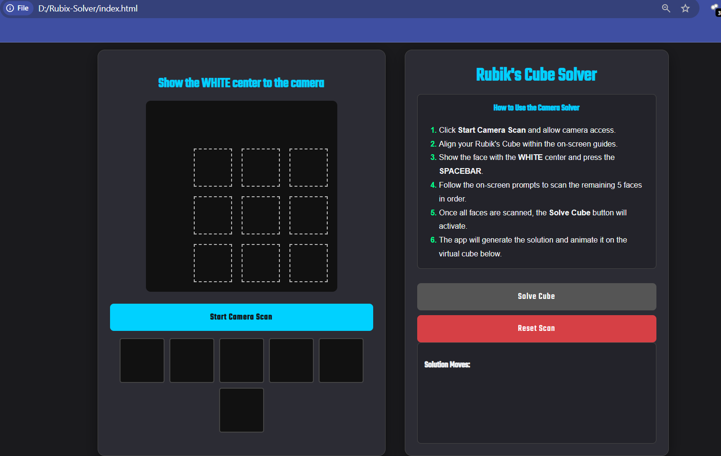
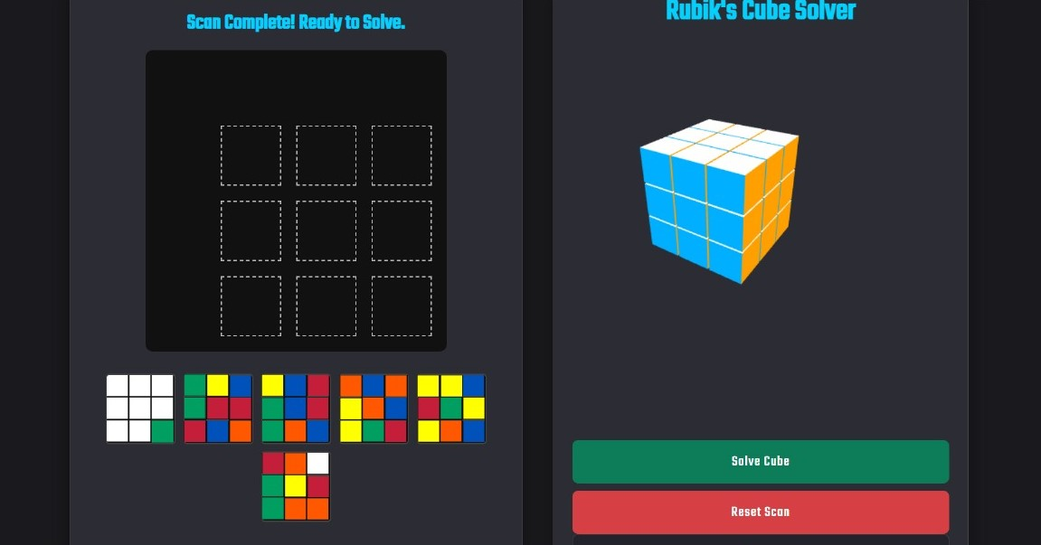
OUTPUT :
GitHub : https://github.com/Sravanthi-2311/Rubix_Cube_Solver.git
"A good solution doesn’t just solve the cube – it helps others understand the logic behind it."

Slide 11
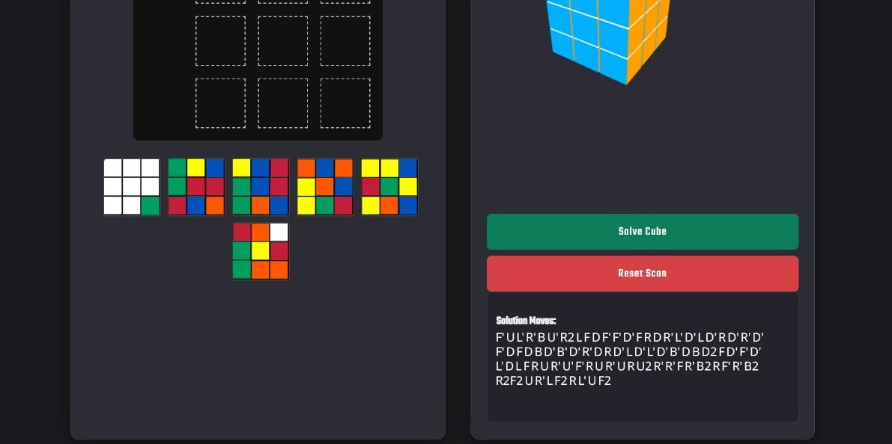
Output of the final moves
"A good solution doesn’t just solve the cube – it helps others understand the logic behind it."

Slide 12
THANK YOU
P.Sravanthi
sravanthip2311@gmail.com
9014573349

